Slide 1
Working Capital Management

Slide 2
Working Capital Management
Working Capital means those liquid funds, whether in the form of cash, deposits in a bank, or either way, which an enterprise keeps to manage the day-to-day running expenses of the business.
Working capital management or short-term financial management which is concerned with decisions relating to current assets and current liabilities.
Short-term financial decisions typically involve cash flows within a year or within the operating cycle of the firm.

Slide 3
Concepts of Working Capital
There are two concepts of working capital:
Gross working capital: Gross working capital is the total of all current assets.
Net Working Capital: Net working capital is the difference between current assets and current liabilities.
Working Capital = Current Assets – Current Liabilities

Slide 4
Current Assets
Current assets are those resources which a company owns and expects to convert into cash during a financial year.
These get sold, exhausted or consumed due to the ordinary course of operations of the business.
Components of Current Assets
Cash and Cash Equivalents
Marketable Securities
Account Receivables
Inventory
Pre-paid Expenses

Slide 5
Current Liabilities
Current liabilities are an enterprise’s obligations or debts that are due within a year or within the normal functioning cycle.
Accounts Payable/Trade Payable
Bank Overdrafts
Short Term Loan
Outstanding Expenses

Slide 6
Factor Affecting Working Capital requirement
Nature of Business
Size of Business
Seasonality of Operations
Length of Production Cycle
Terms of Purchase and sales

Slide 7
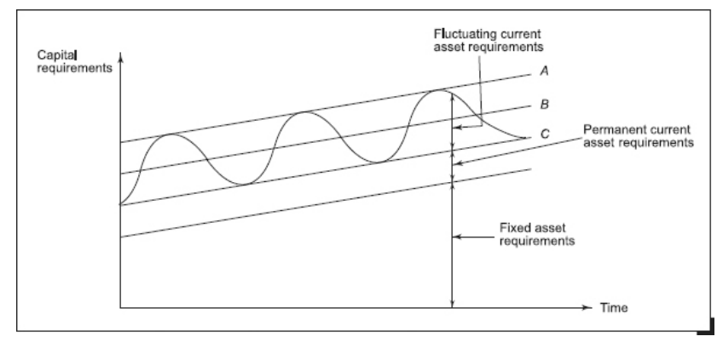
Capital Requirements and Their Financing

Slide 8
The Different Working Capital Financing Policies
Conservative Policy
Aggressive Policy
Matching Policy

Slide 9
Operating cycle and cash cycle
The investment in working capital is influenced by four key events in the production and sales cycle of the firm:
Purchase of raw materials
Payment for raw materials
Sale of finished goods
Collection of cash for sales

Slide 10
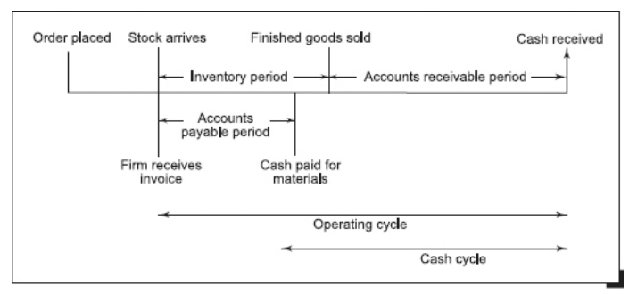
Conti…

Slide 11
Conti…
The time that elapses between the purchase of raw materials and the collection of cash for sales is referred to as the operating cycle,
whereas the time length between the payment for raw material purchases and the collection of cash for sales is referred to as the cash cycle.

Slide 12
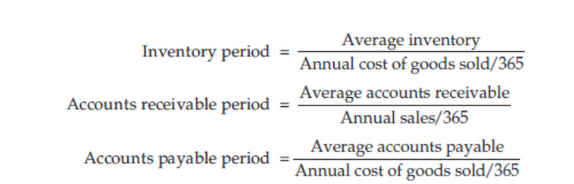
Conti….

Slide 13
Methods of Working Capital Estimation
Operating cycle methods
Current assets holding period Method
Ratio to sales method
Ratio of fixed investment method

Slide 14
Example
A pro forma cost sheet of a company provides the following data. The following is the additional Information
Average raw material in stock: one month
Average Material in Process: half month
Credit Allowed by suppliers: one month
Credit Allowed to customers: half month
Time lag in payment of wages: half month
Time lag in payment of overhead: one month
One forth of sale is on cash basis
Cash balance is expected to be 120,000
You are required to prepare a statement showing working capital requirement at 70000 units of output.
S. No | Particulars | Amount
1 | Raw Material (Per unit) | 52
2 | Direct Labour (Per unit) | 19.5
3 | Overheads (Per unit) | 39.0
 | Total Cost (Per unit) | 110.5
 | Profit (Per unit) | 19.5
 | Selling Price (Per unit) | 130

Slide 15
Example -2
Manoma creation wants a project to be put into operation with effect from 1st January 2021 and the management desires to know the quantum of working capital required to finance the project. The company management provides the following information.
Production during 2021is expected to be 1,00,000 units. The percentage of production cost to selling price has been as under:
Material 50%
Labour 20%
Overheads 10%
Following further particulars are available:
Raw materials are expected to remain in stores for the average period of one month before issue to production.
Finished goods are to stay in the warehouse for two months on the average before being sold.
Each unit of production will be in process for one month on the average.
Credit allowed by creditors in respect of purchase of raw materials is 1 month.
Debtors are allowed two months’ credit from the date of the sale of the goods.
Selling price is fixed at Rs. 9/- per unit.
Prepare an estimate of Working Capital Requirement from the above information.

